Slide 1
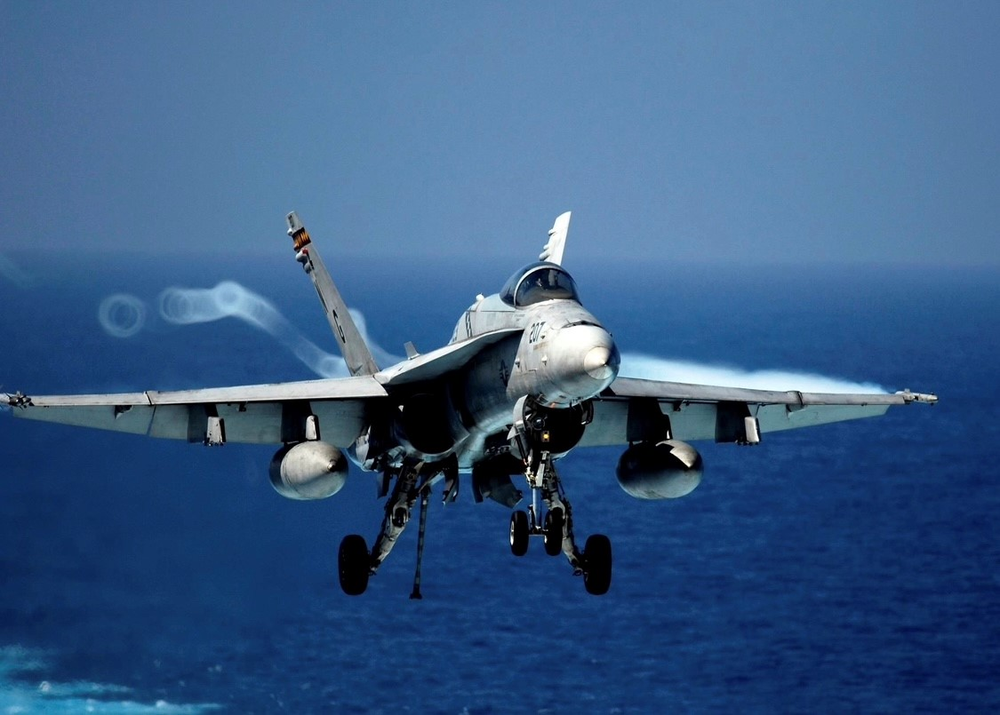

Modelgeeks Podcast Present: Painting and Weathering Aircraft

Slide 2
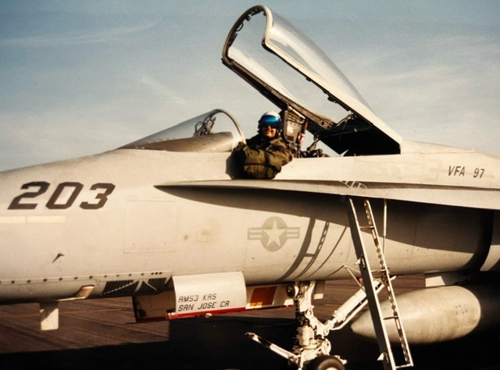
F/A-18A, VFA-97, 1999 LT Gabe “Rage” Pincelli
Agenda:
Weathering: Step by Step Process
Modern Jets and Props
A Few Sea Stories..
Wrap up

Slide 3
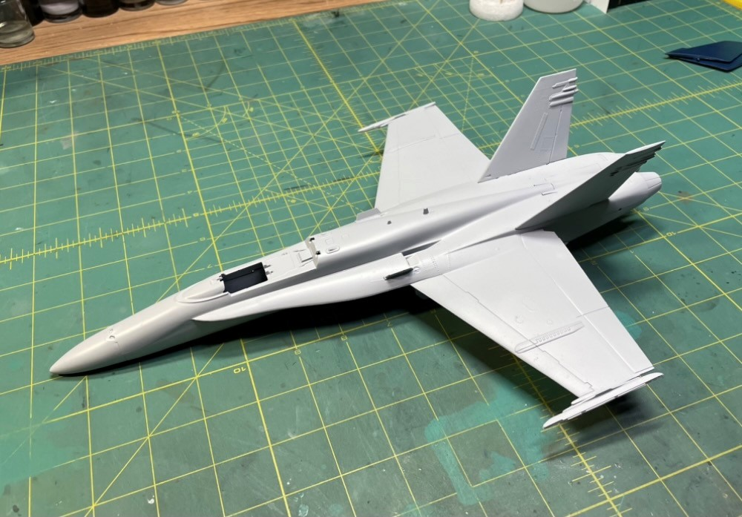
Step 1: Surface Prep
Need a nice smooth surface
Not always necessary to prime
Recessed vs Raised Panel Lines
Least amount of paint on the surface

Slide 4
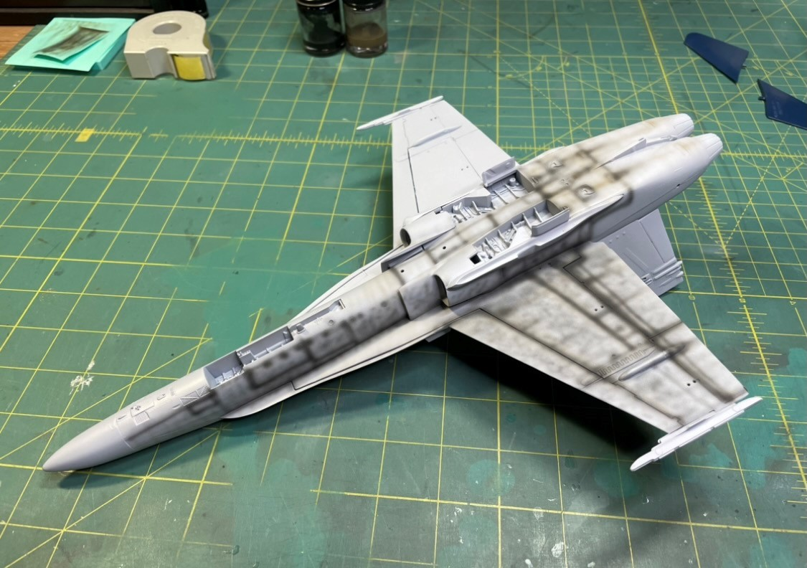
Step 2: Foundational Weathering Layer (Pre-Shade)
Underneath colors for weathering
Tamiya Acrylic Flat Black (XF-1)
60% Thinner
40% Paint
Use other colors
Brown, Green, Red, Orange, Blue
Use References to shade appropriate areas
Heavier under engine areas and crevices

Slide 5
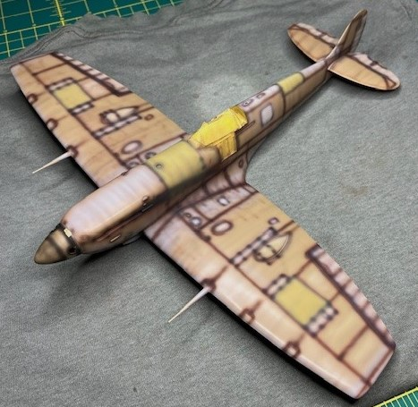
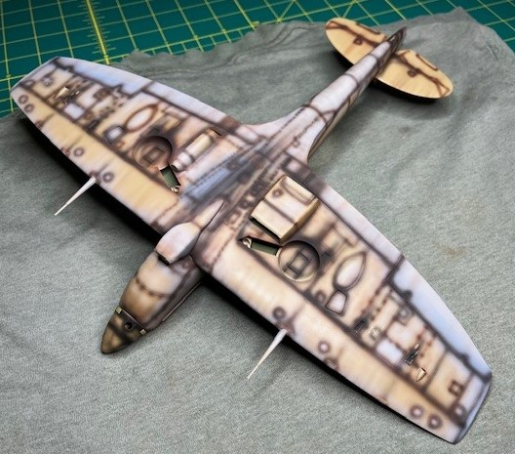
Step 2: Foundational Weathering Layer
Mr Surfacer 1000 Mahogany, Tamiya Black Brown Mix, Tamiya Light Gray and Yellow

Slide 6
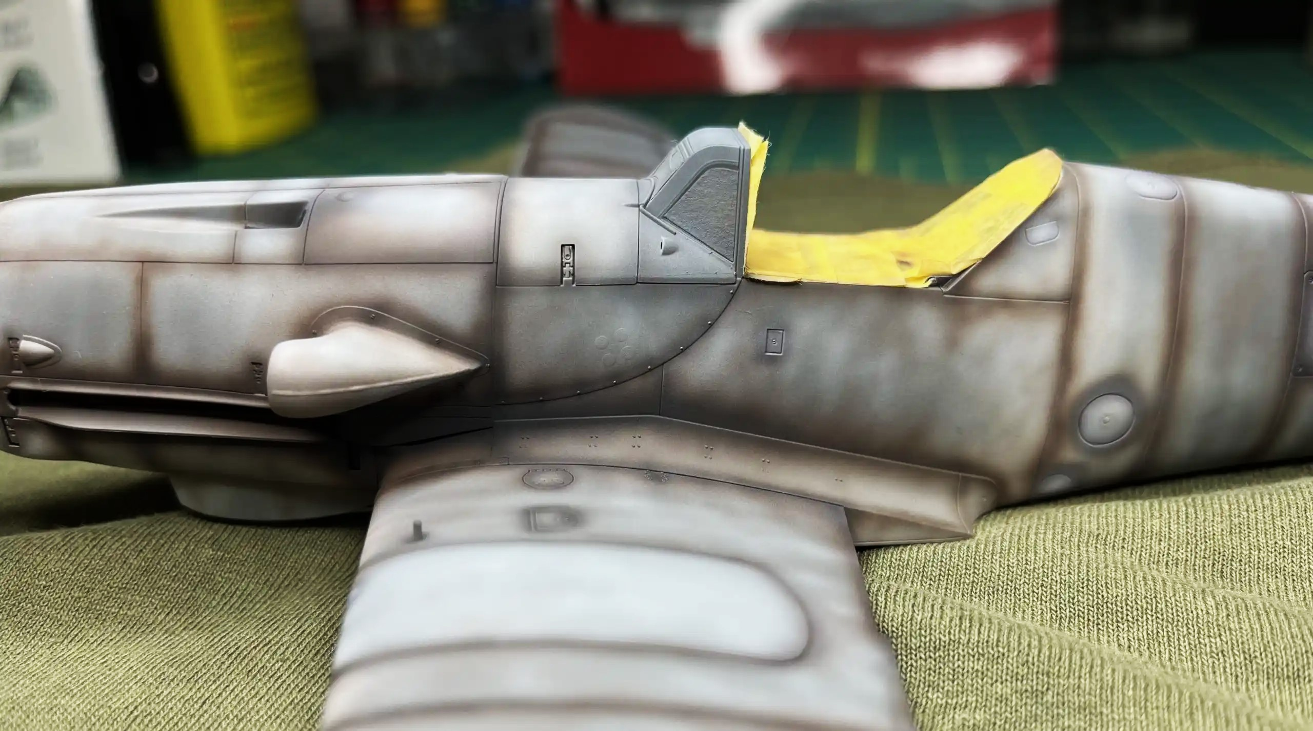
Step 2: Foundational Weathering Layer
Mr Surfacer 1000 Mahogany, Tamiya Black Brown Mix, Tamiya Light Gray

Slide 7
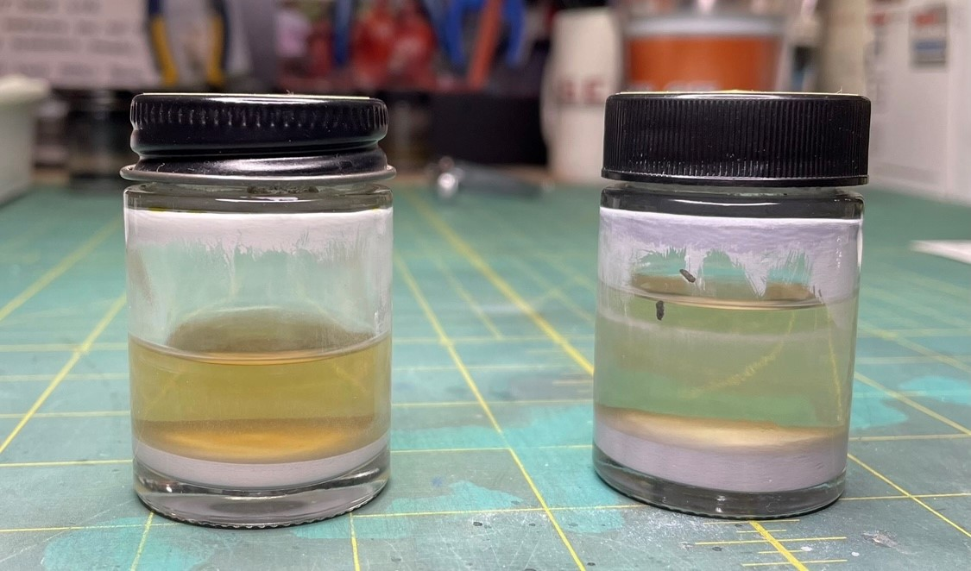
Step 3: Base Color
70-80% Thinner
20-30% Paint
12-15 PSI
Take your time, don’t rush
Matte paint vs semi-gloss
Idea is to build up layers to give depth to the finish

Slide 8
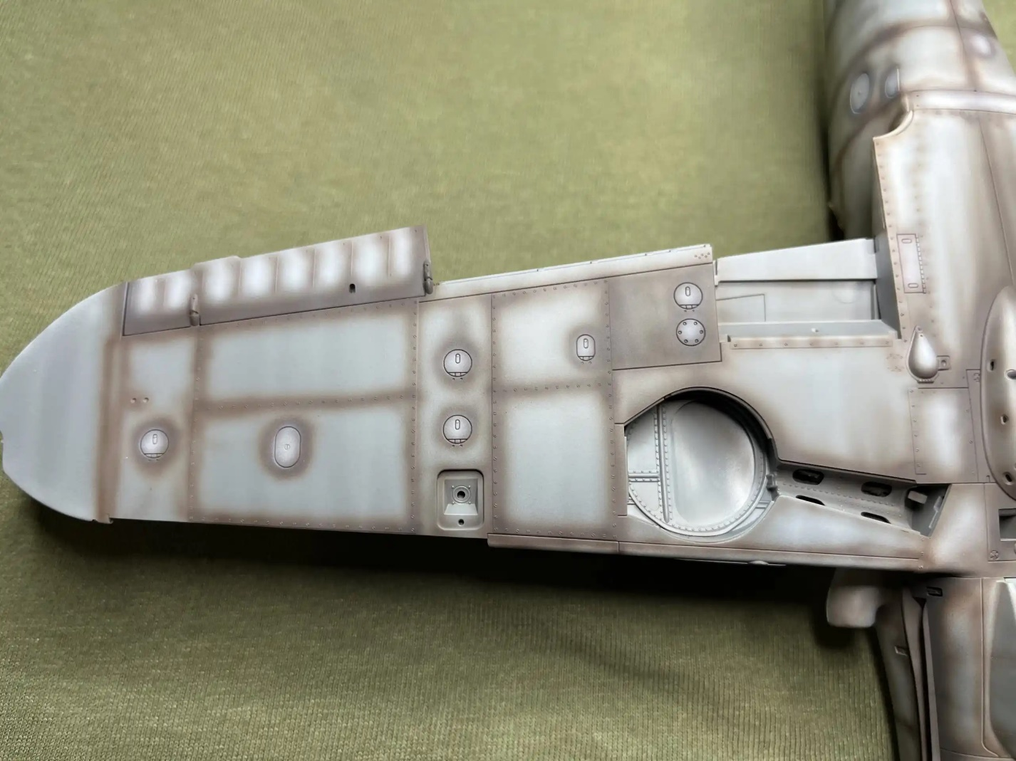
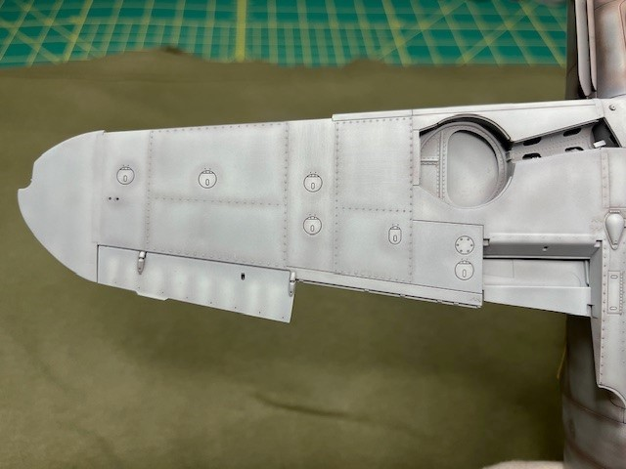
Step 3: Base Color
Foundational layer of Mr. Surfacer 1000 Mahogany, followed by a thin base coat Gunze Aqueous H-417 (RLM 76)

Slide 9
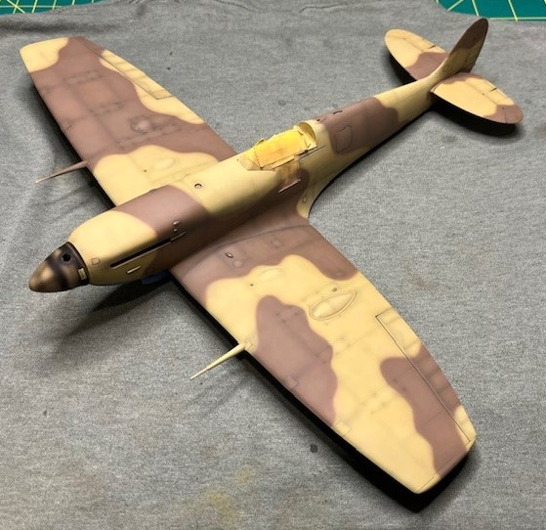
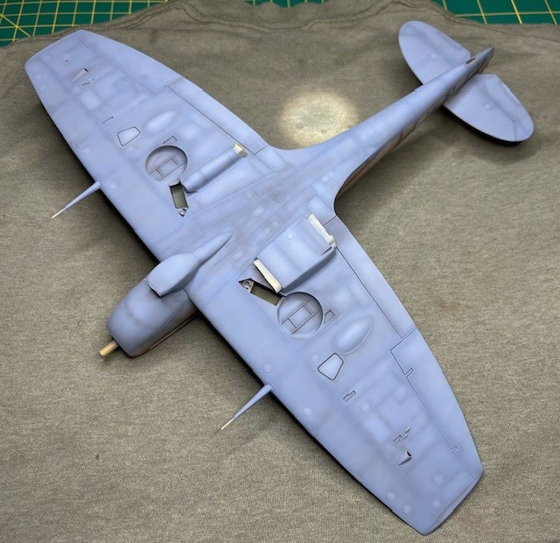
Step 3: Base Color (Initial Camo Layer)
Base layer: Gunze Aqueous Middle Stone (H-71) and Dark Earth (H-72). Custom Mixed Tamiya Azure Blue

Slide 10
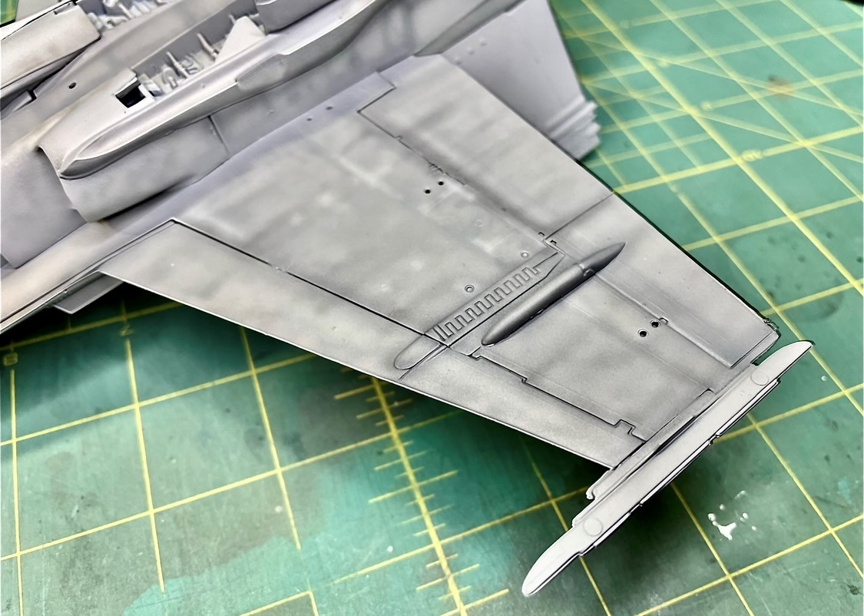
Step 4: Post Shade (Lowlight and Highlight)
70% Thinner
30% Paint
12-15 PSI
Lowlight (Darker Color) First
Highlight (Lighter Color) Second
Base color with a drop of White
Pick out a few panels
Colors can be various shades
Reference pics

Slide 11
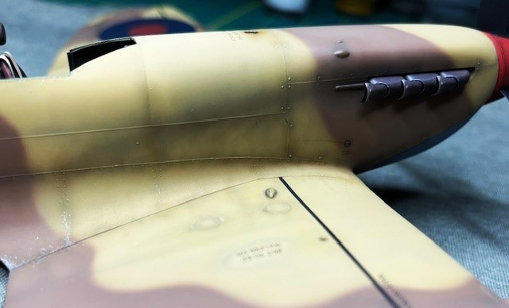
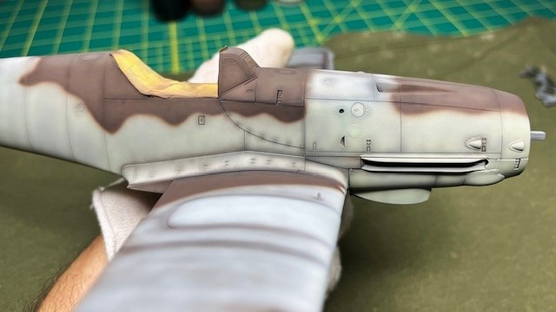
Step 4: Post Shading
Post shading with darker and lighter shades of the base color, followed by Tamiya Black/Brown mix

Slide 12
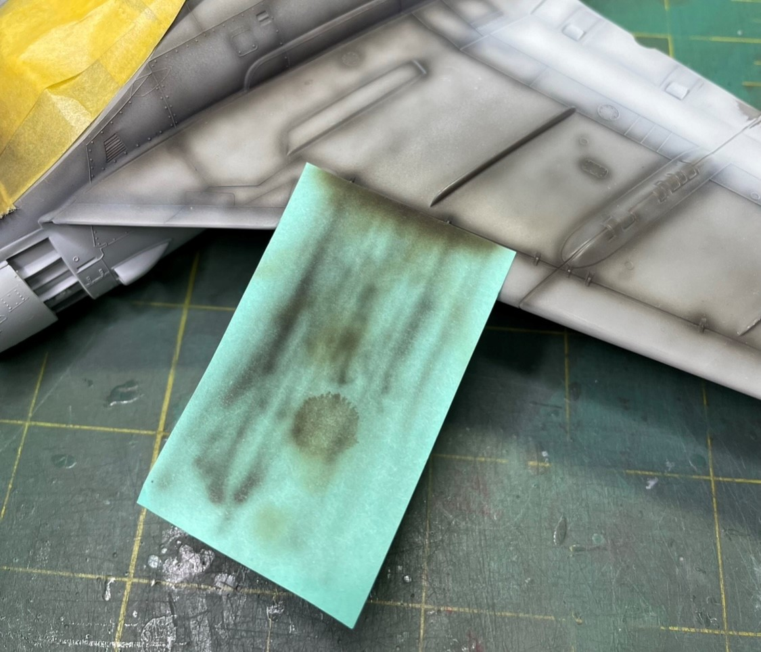
Step 5: Post-It Note (Streaking)
70% Thinner
30% Paint
12-15 PSI
Use a dark color; black, dark gray, or dark brown
Streak aft in a quick motion

Slide 13
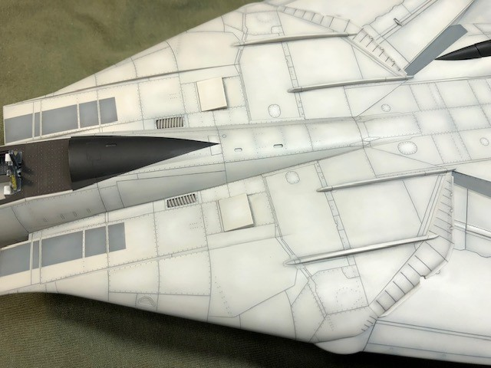
Step 6: Panel Line Wash
Use Dissimilar Products
Enamel Wash on Acrylic Paint
My favorite is Tamiya Enamel Panel Line Accent Color (Black or Black/Brown)
Remove with Odorless Thinner and a Q-Tip
Use Ronsonol Lighter Fluid for stubborn areas
Wash before decals

Slide 14
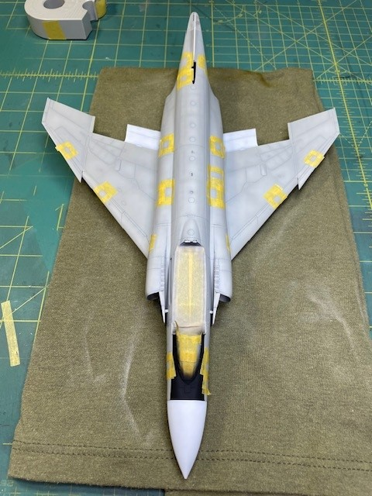
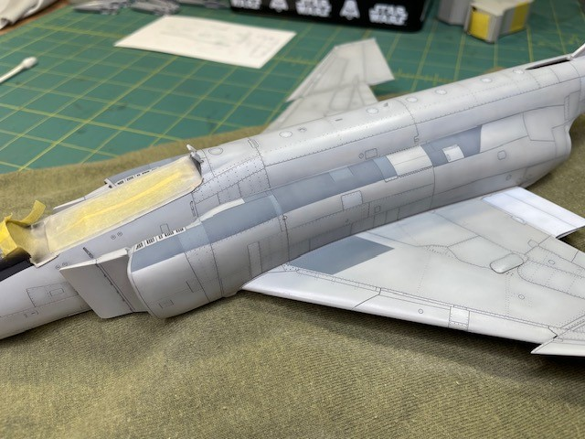
Step 7: Individual Panel Highlight

Slide 15
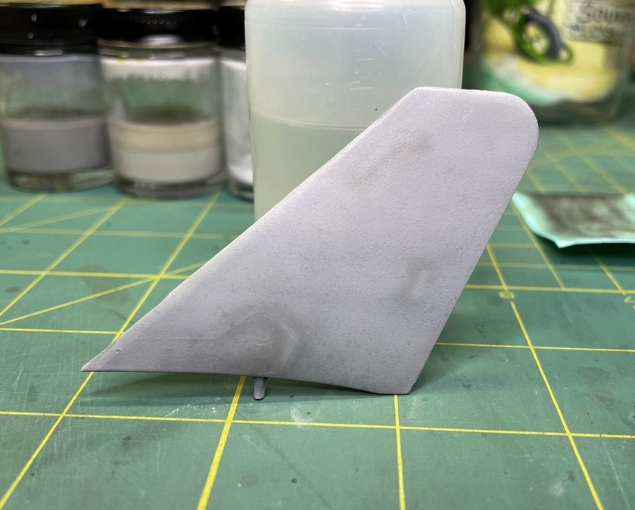
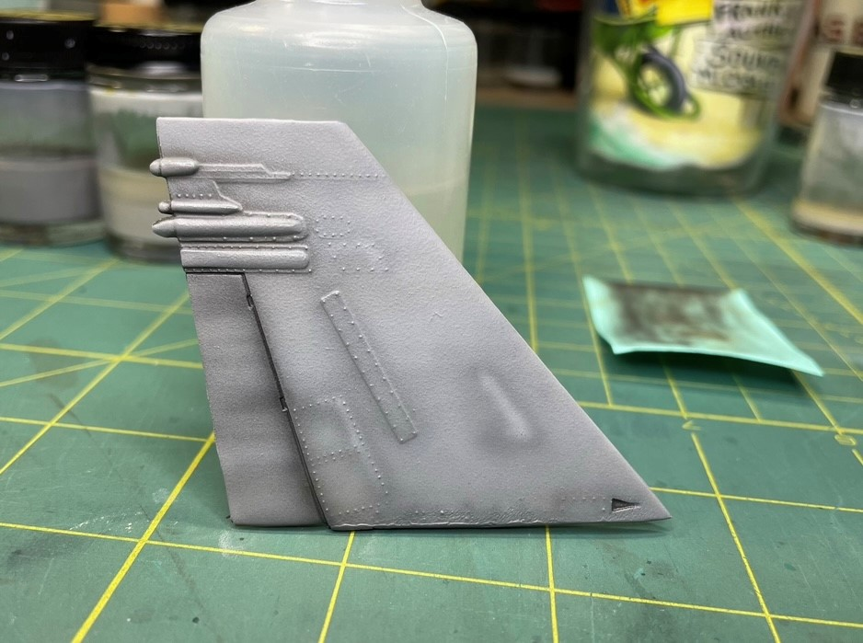
Step 8: Weathering Effects (Speckling, Washes, etc..)

Slide 16
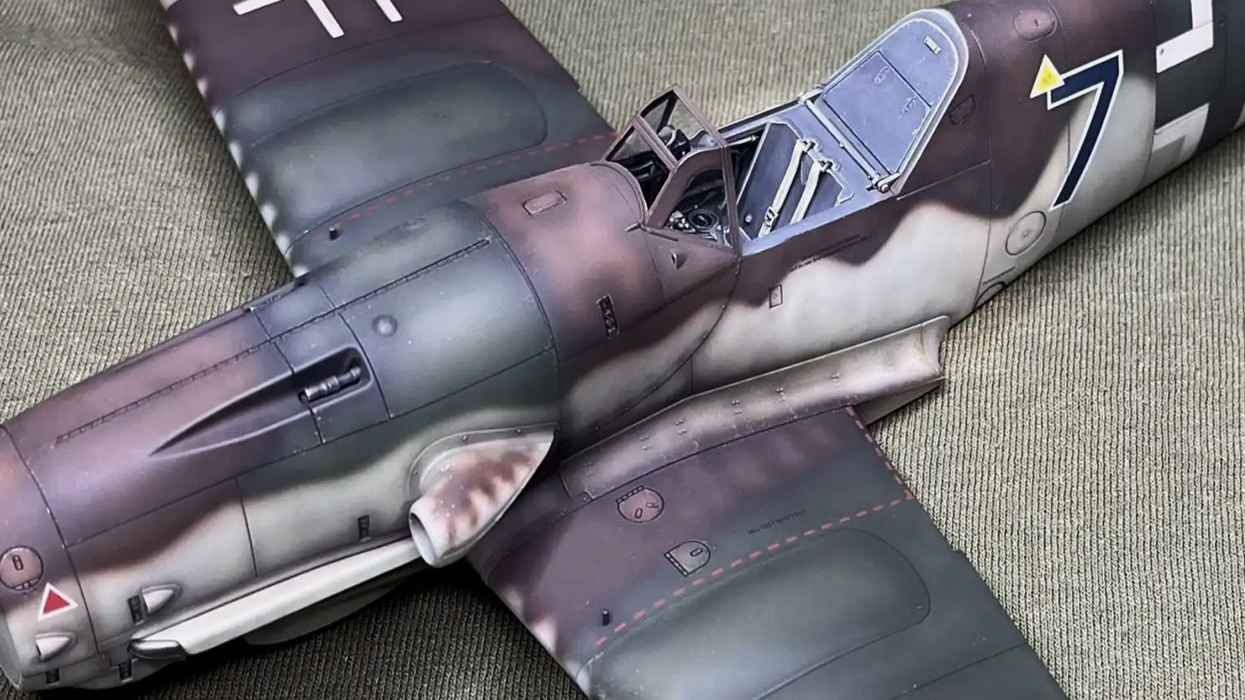
Step 9: Final Weathering Effects (Tamiya Black/Brown Mix)
80% Thinner
20% Paint
12-15 PSI
Use a dark color; black, dark gray, or dark brown
Concentrate on crevices, wing roots, engine areas

Slide 17
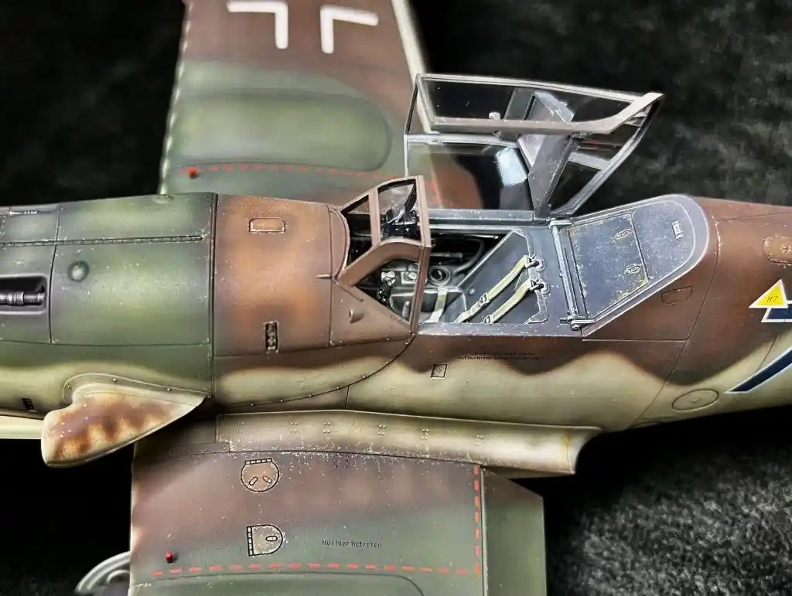
Step 9: Final Weathering Effects (Chipping)
Prisma Color Pencils
Fine chips; go slow
Use a variety of colors; not just silver
Concentrate on wear areas; wing roots, leading edges, access hatches, etc..

Slide 18
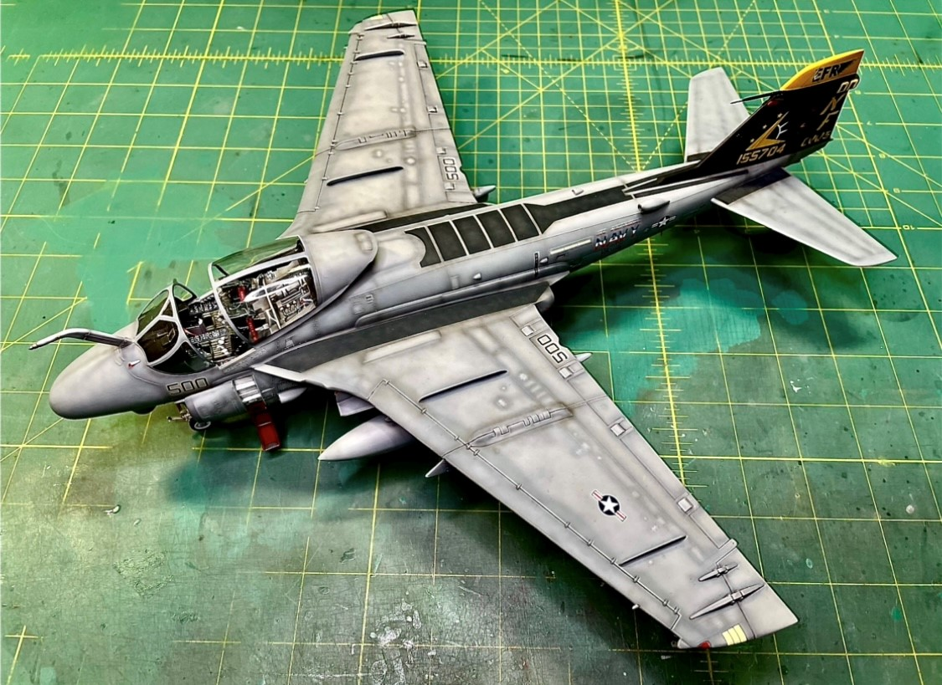
Finished TPS Camo, Revell 1/48 A-6E

Slide 19
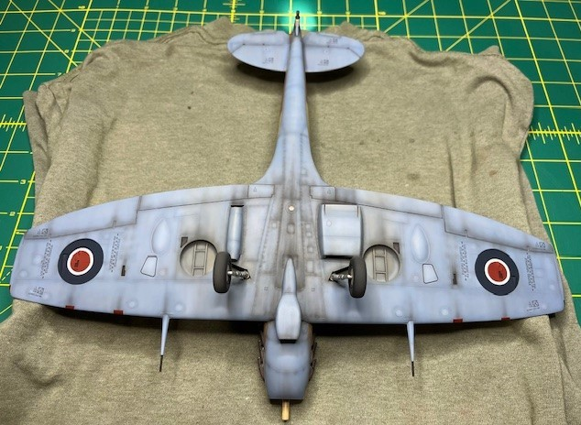
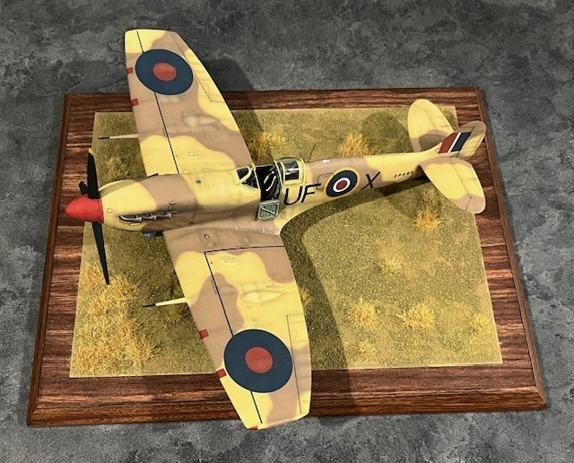
Finished Model: Hasegawa 1/32 Spitfire Mk.Vc

Slide 20
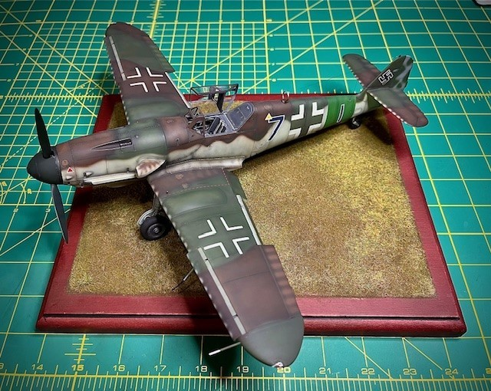
Finished Model: Kotare 1/32 Bf-109K-4

Slide 21
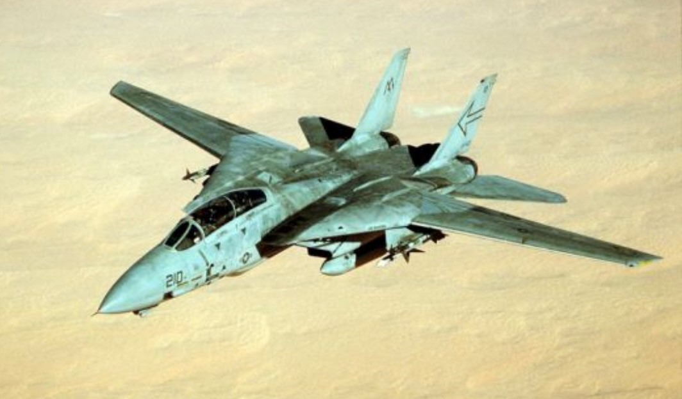

Questions??

