Slide 1
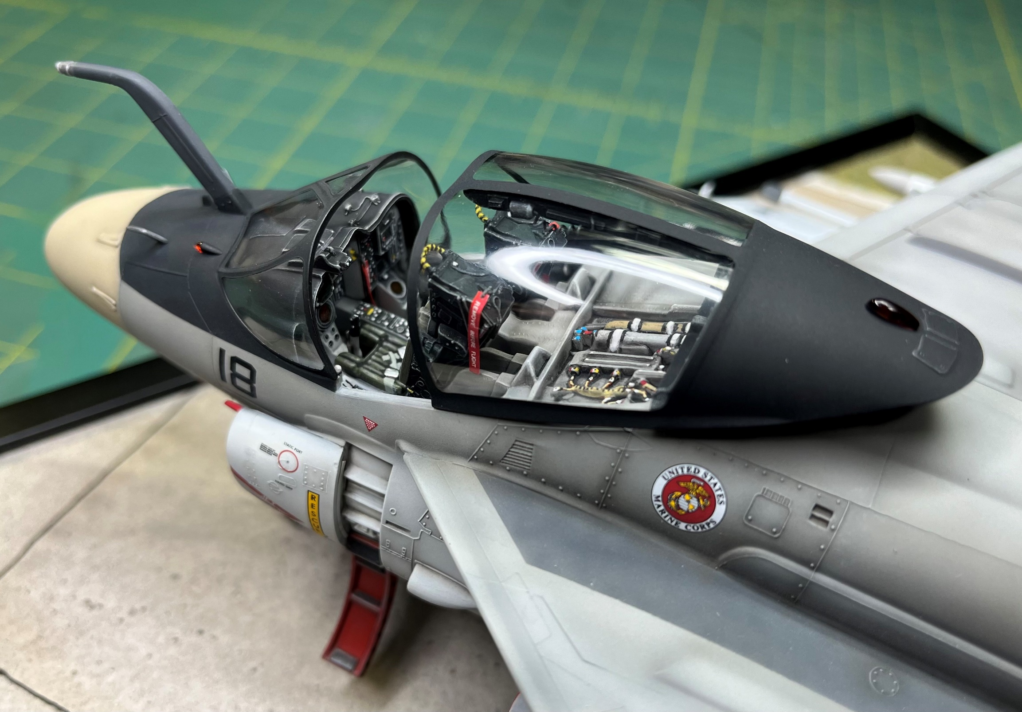

Modelgeeks Podcast: Painting Cockpits

Slide 2
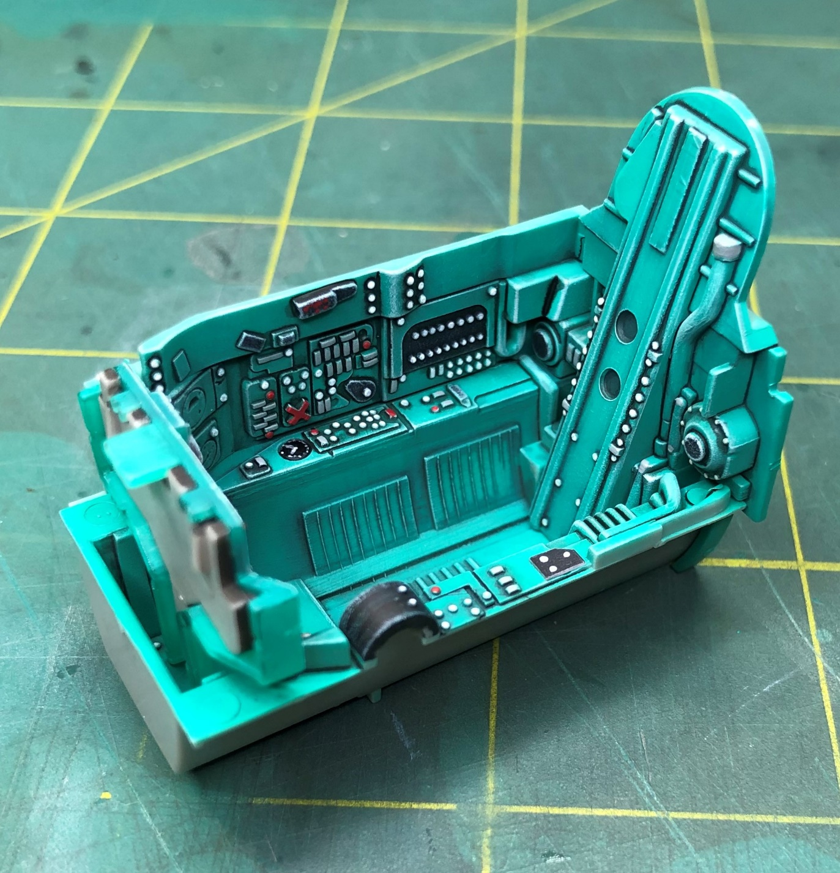
Trumpeter 1/32 Mig-21, OOB Cockpit
Agenda:
Painting Cockpits, Step by Step
Tamiya 1/48 F-4B
Built Cockpit Examples
Jets and Props
Simple Scratch Build Items
Easy Cockpit Enhancements
Tools, Tips, and Techniques
More Sea Stories…

Slide 3
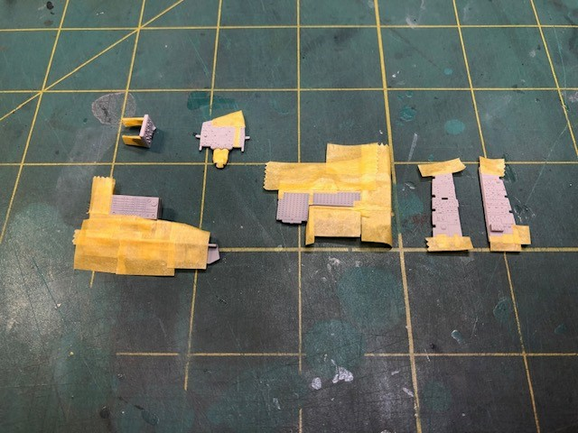
Step 1 (F-4B): Tape the Instruments and Consoles
Once the base color is sprayed, decide which areas need tape
Use Tamiya Tape
Use a sharp Xacto Knife to cut
Take your time
Don’t have to be exact
Crisp and Clean Lines is the goal

Slide 4
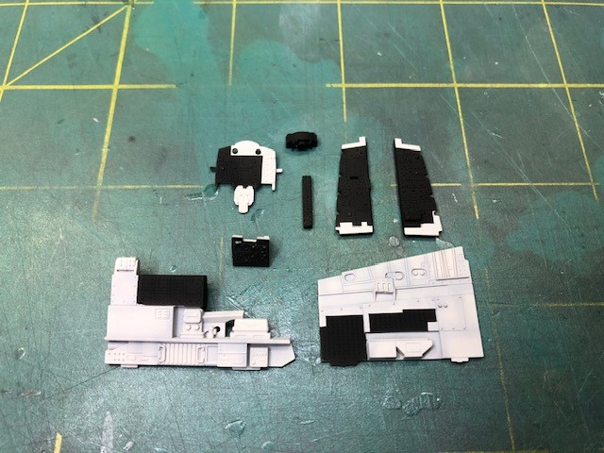
Step 2 (F-4B): Spray the Instruments and Consoles
Choose the color for the consoles and Instruments

Slide 5
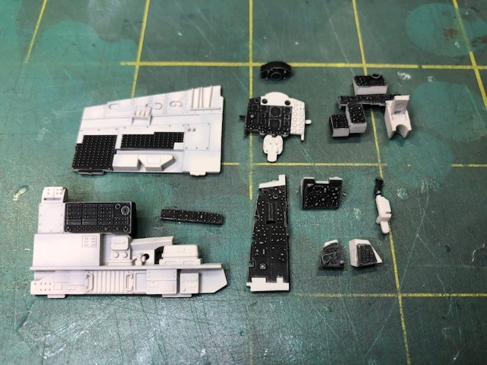
Step 3 (F-4B): Drybrush Neutral Gray
Use an older flat and soft brush
Very little paint on the brush
Quick back and forth motion, gradually building up the paint
The gray provides a foundational layer for the switches and details

Slide 6
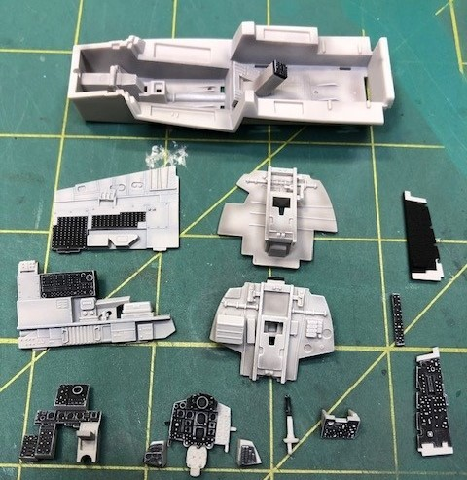
Step 4 (F-4B): Drybrush White
Same principle as using Neutral Gray
Use Tamiya XF-2 Flat White

Slide 7
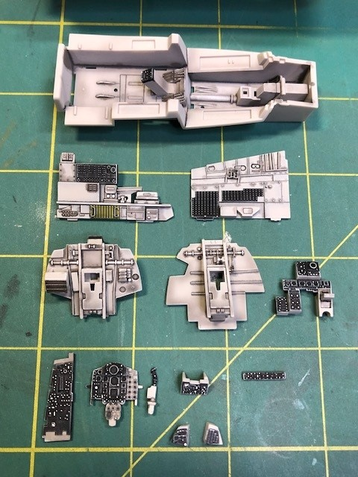
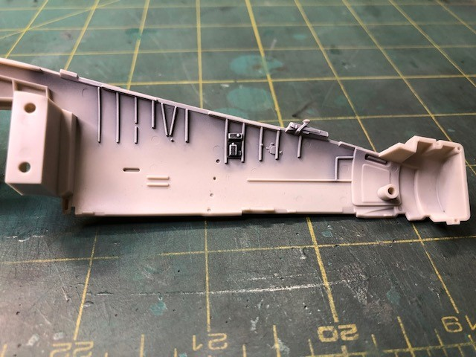
Step 5 (F-4B): Pick out the Details and Apply a Wash

Slide 8
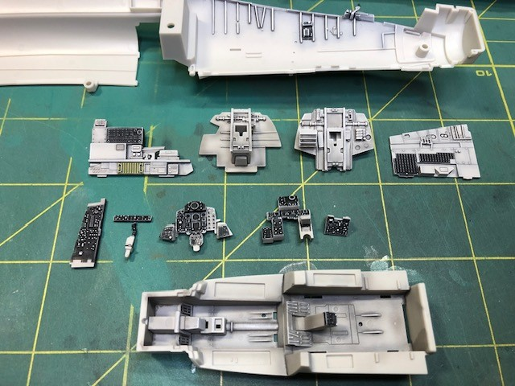
Step 6: Remove the Wash and Blend
Use a Q-Tip to remove the wash
Blend the wash so there are no stark areas

Slide 9
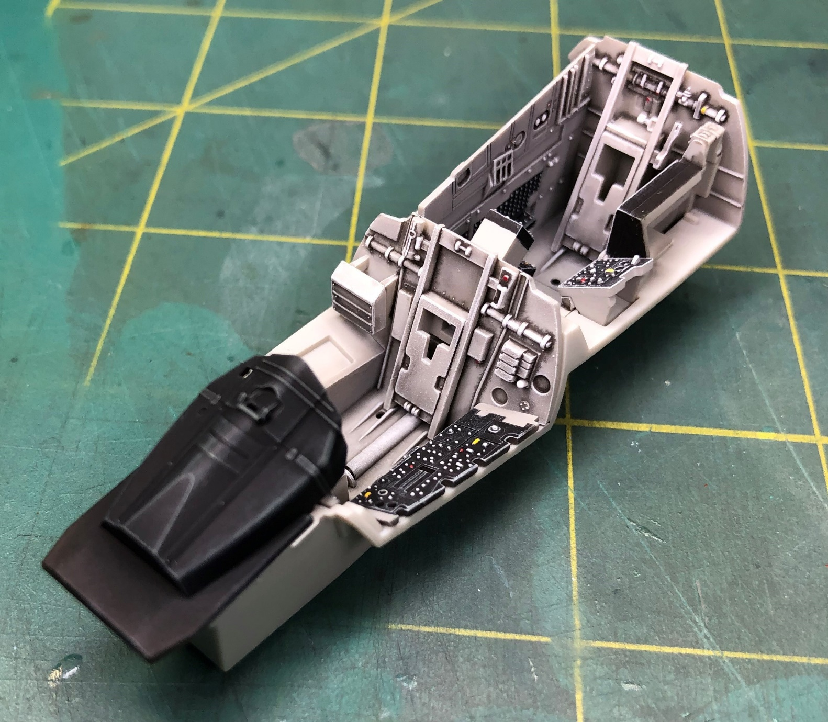
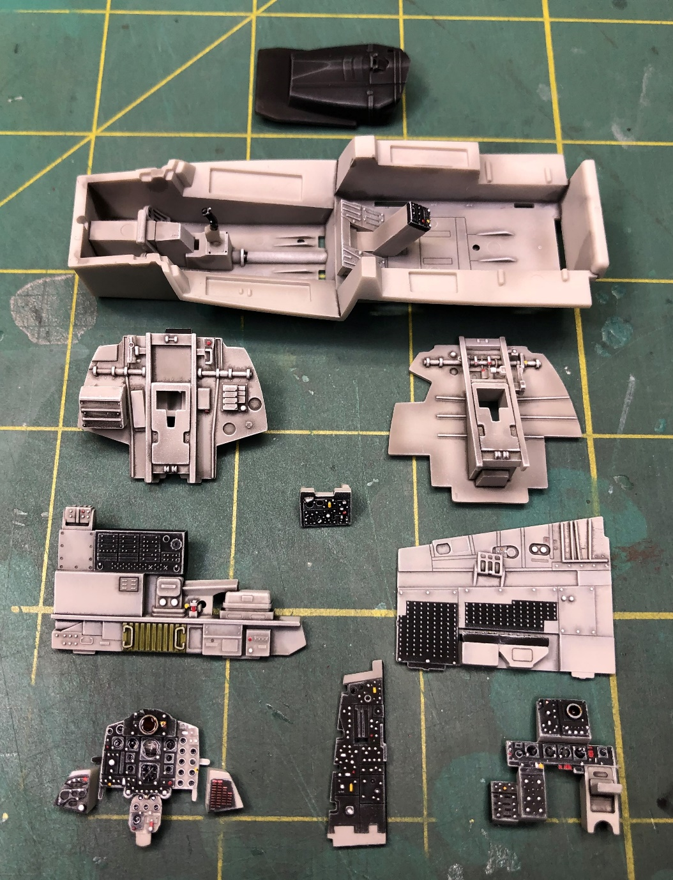
Step 7 (F-4B): Final Detail Painting

Slide 10
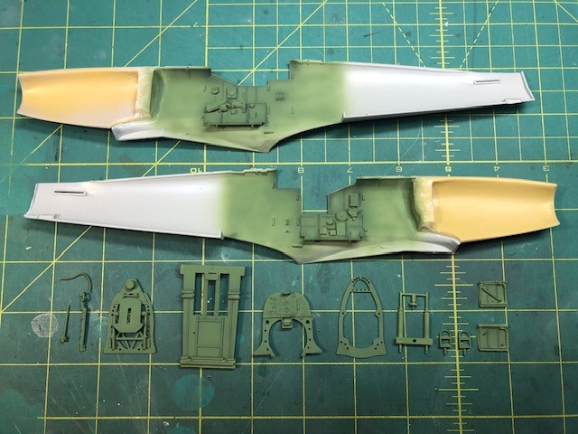
Hasegawa/Paragon 1/32 Mk. XIV
Same process as the F-4:
Base Coat
Dry Brush
Detail Painting and Wash
Blend the Wash
Final Detail Painting

Slide 11
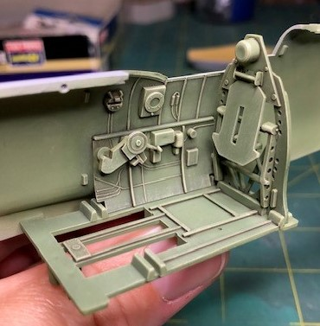
Hasegawa/Paragon 1/32 Mk. XIV: Dry Brush
Base Color mixed with light gray or light tan
Try to avoid lightening with white

Slide 12
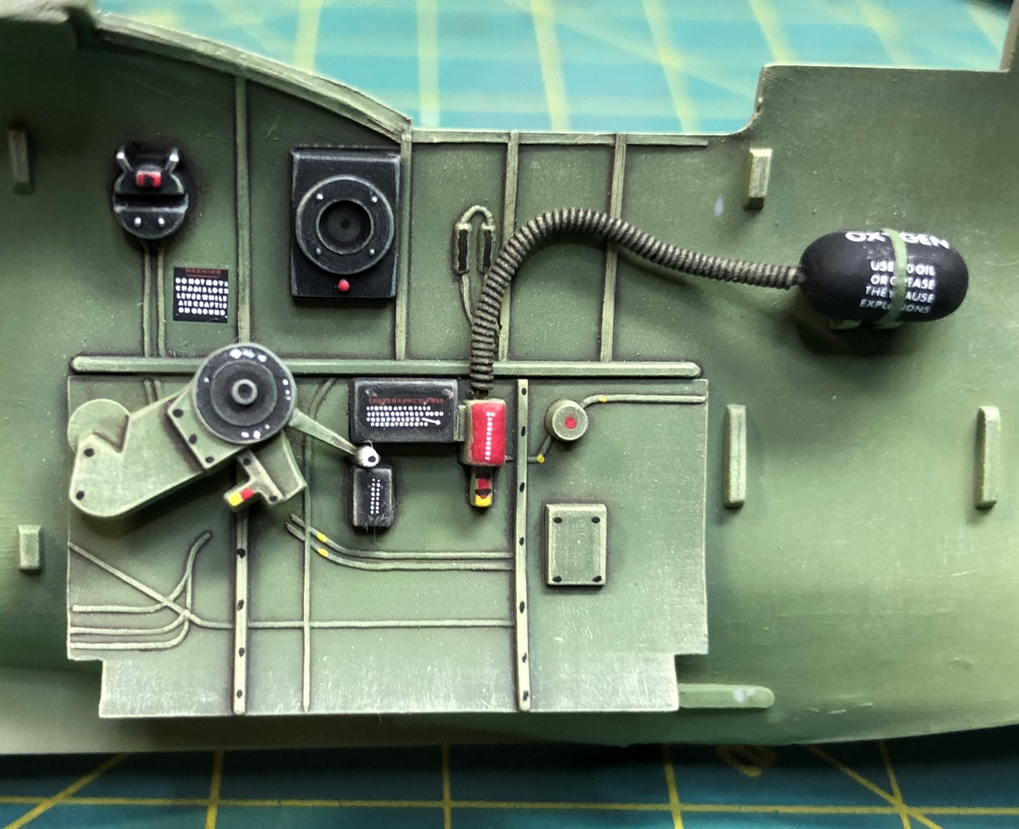
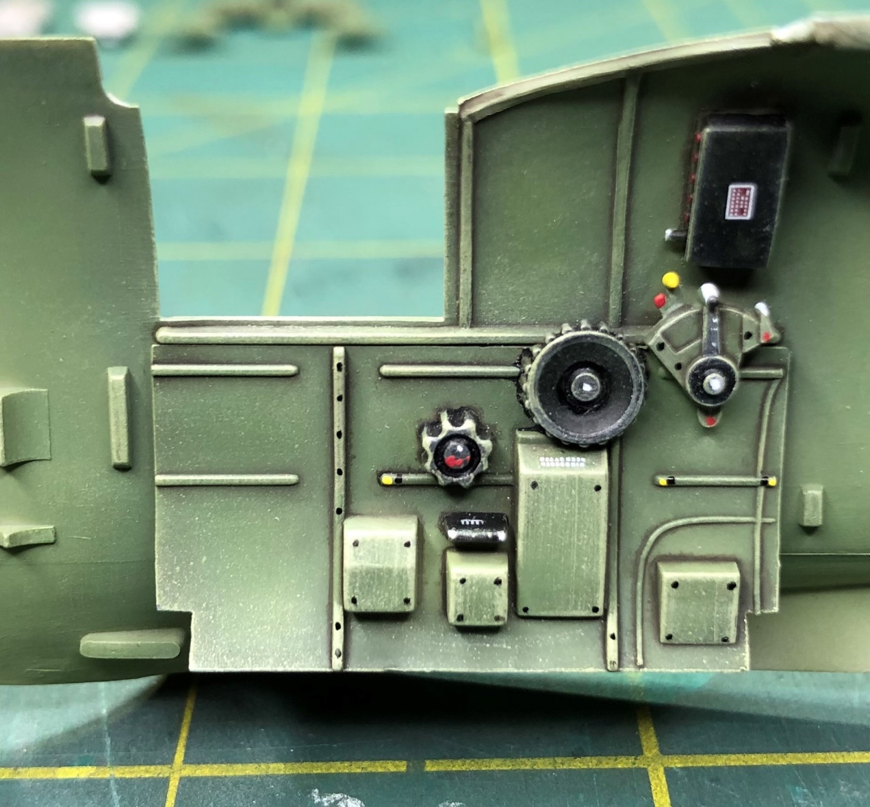
Hasegawa/Paragon 1/32 Mk. XIV: Detail Painting, Wash, and Final Detail Painting

Slide 13
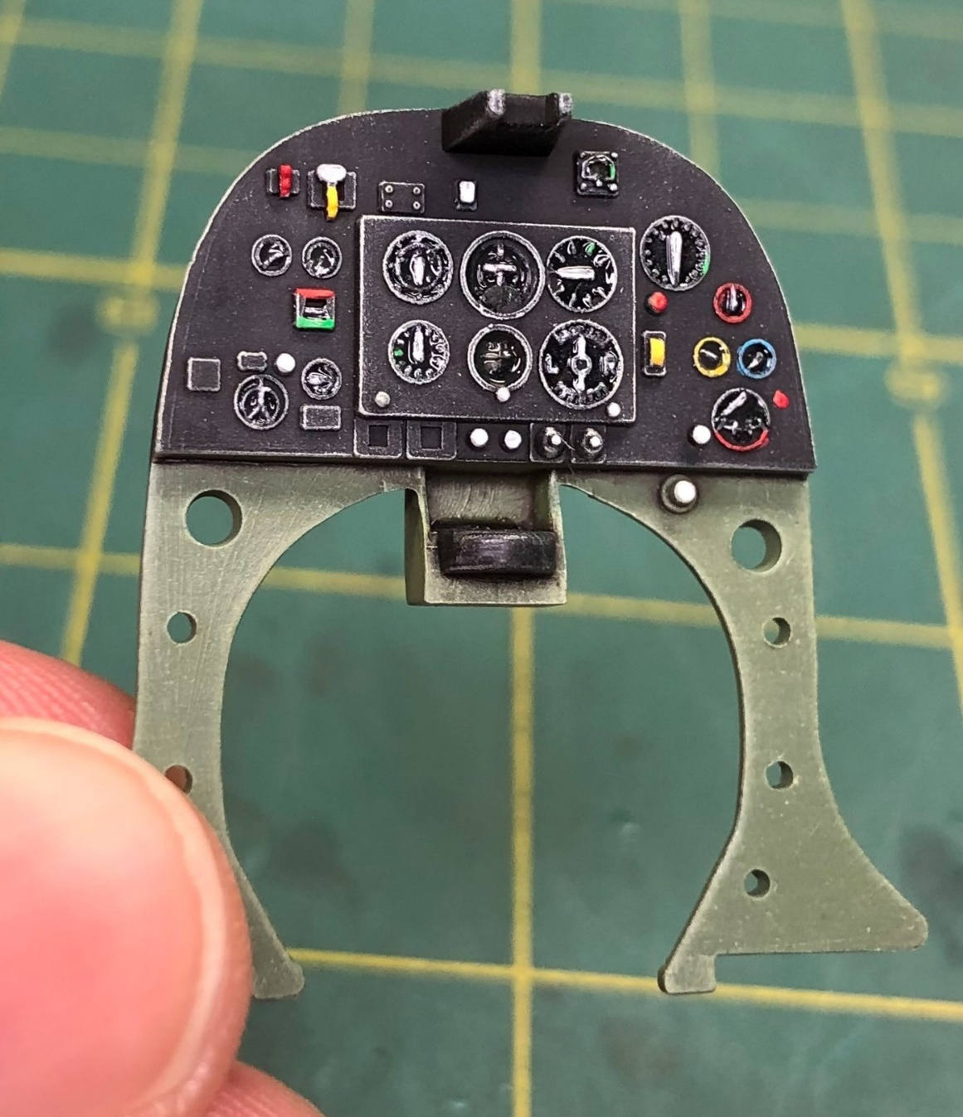
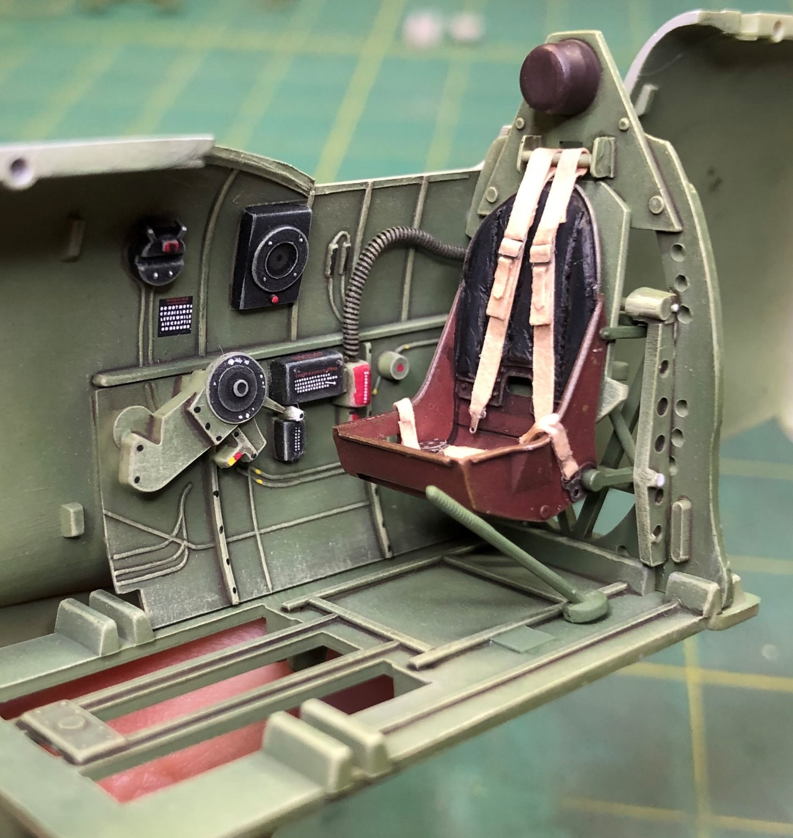
Hasegawa/Paragon 1/32 Mk. XIV: Detail Painting, Wash, Final Detail Painting

Slide 14
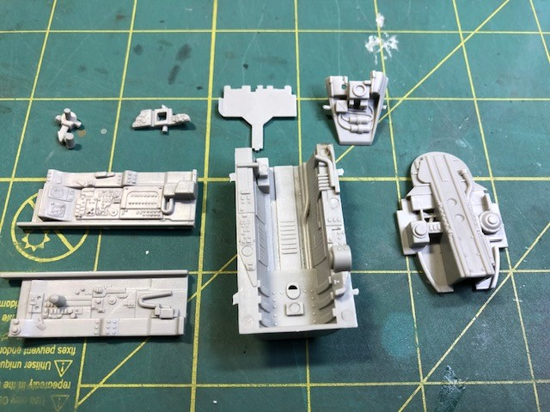
Trumpeter 1/32 Mig 21 Cockpit, OOB

Slide 15
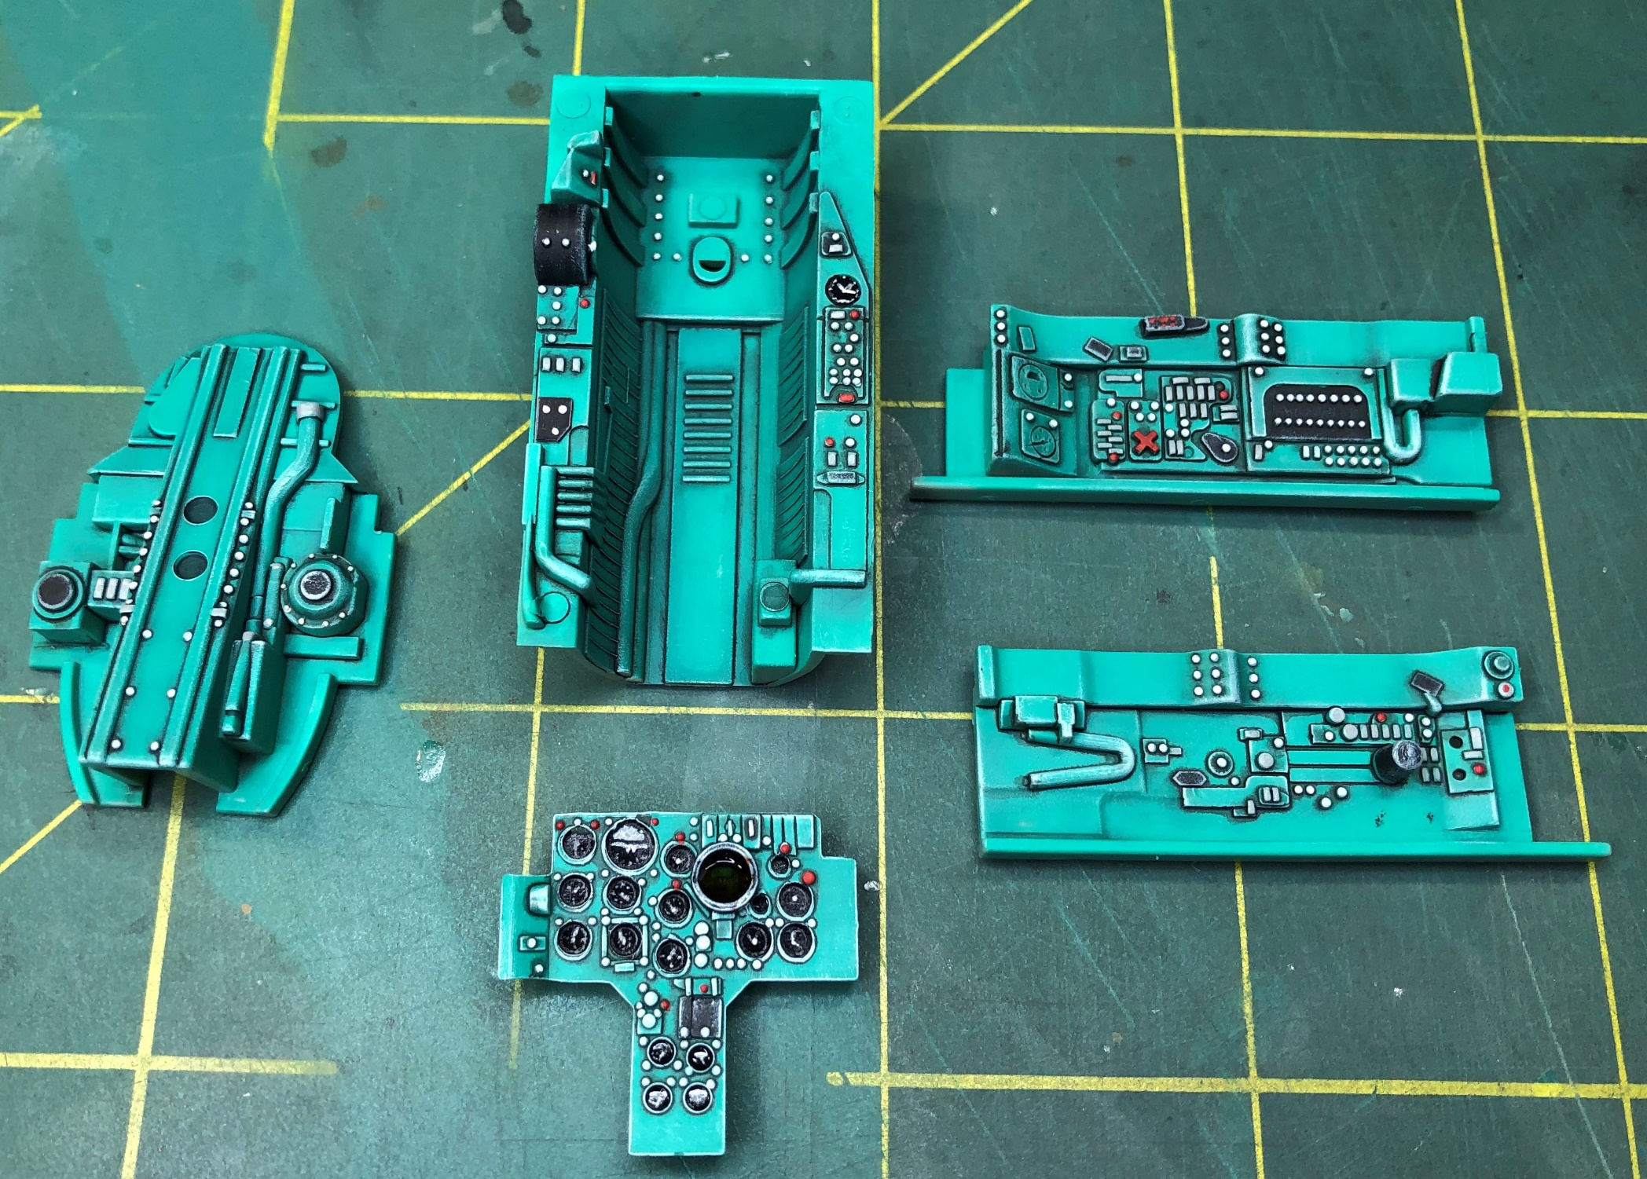
Trumpeter 1/32 Mig 21 Cockpit, OOB

Slide 16

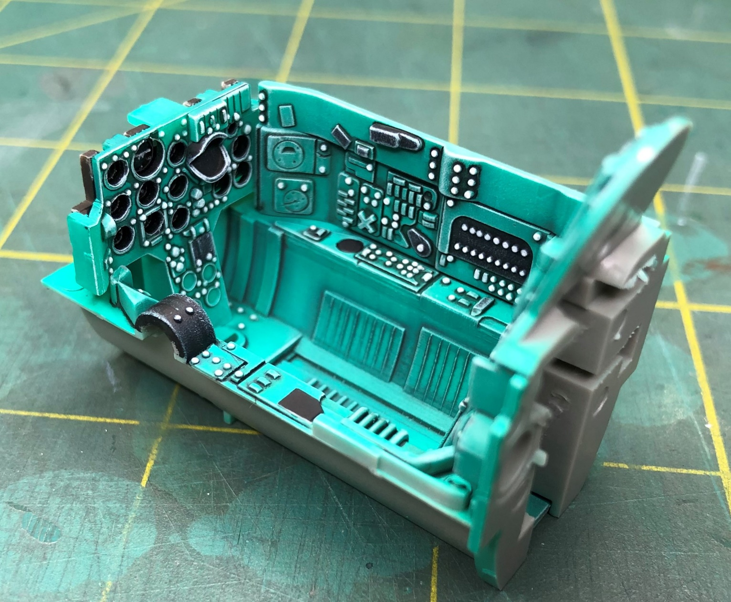
Trumpeter 1/32 Mig 21 Cockpit, OOB

Slide 17
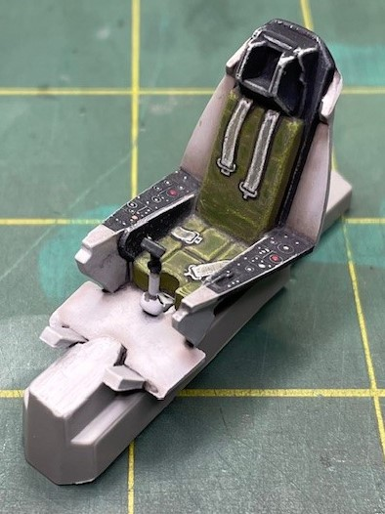
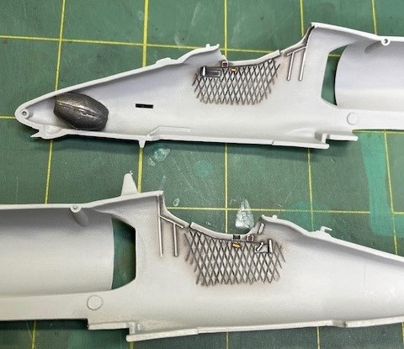
Monogram Cockpits… OOB
1/48 A-4E

Slide 18
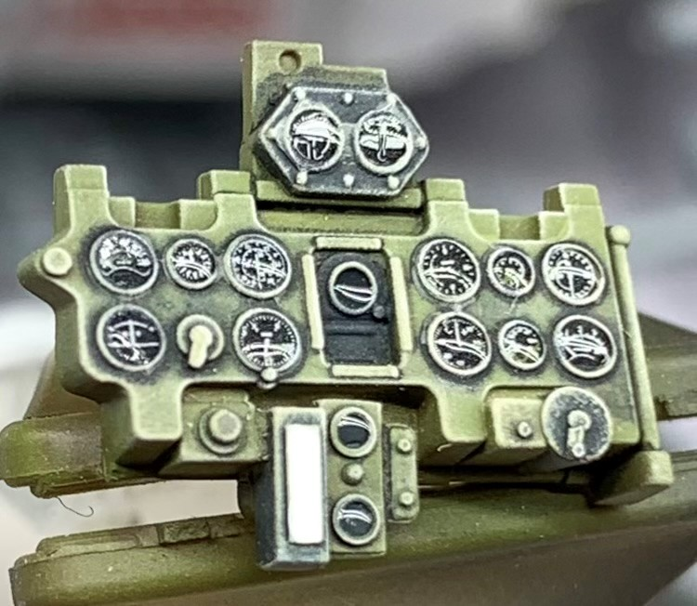
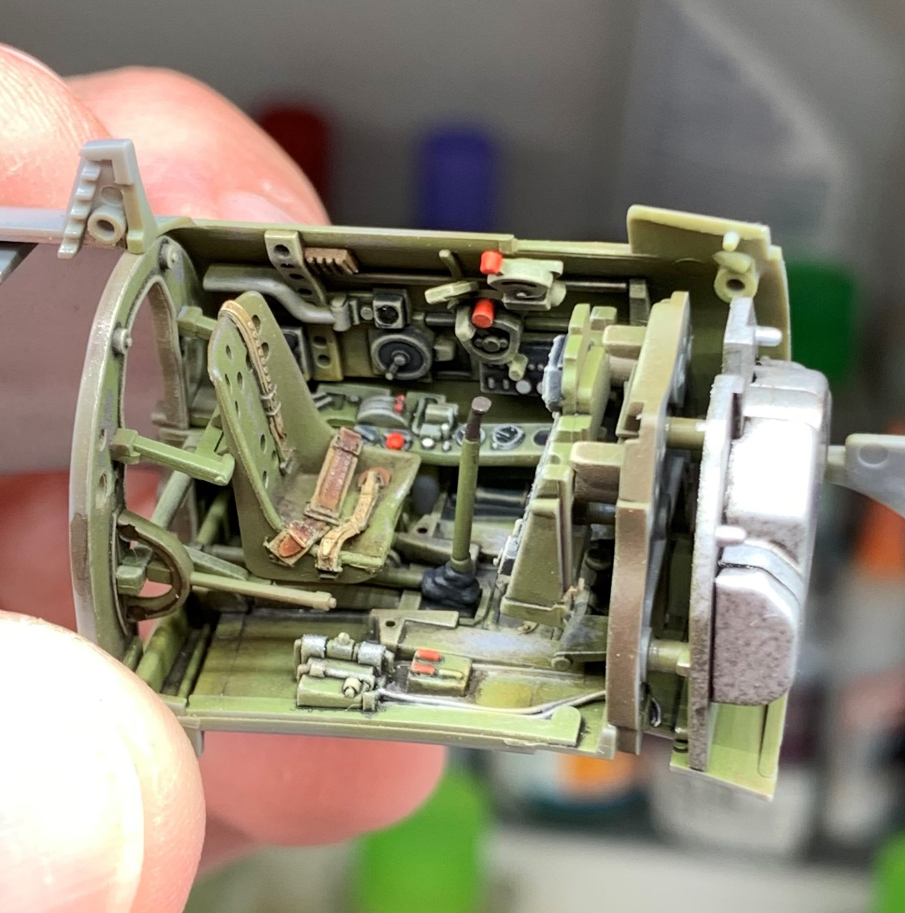
Tamiya 1/48 A6M3 Type 32 Zero Cockpit by Justin Lentz…
Instrument Panel
Seat and Cockpit

Slide 19
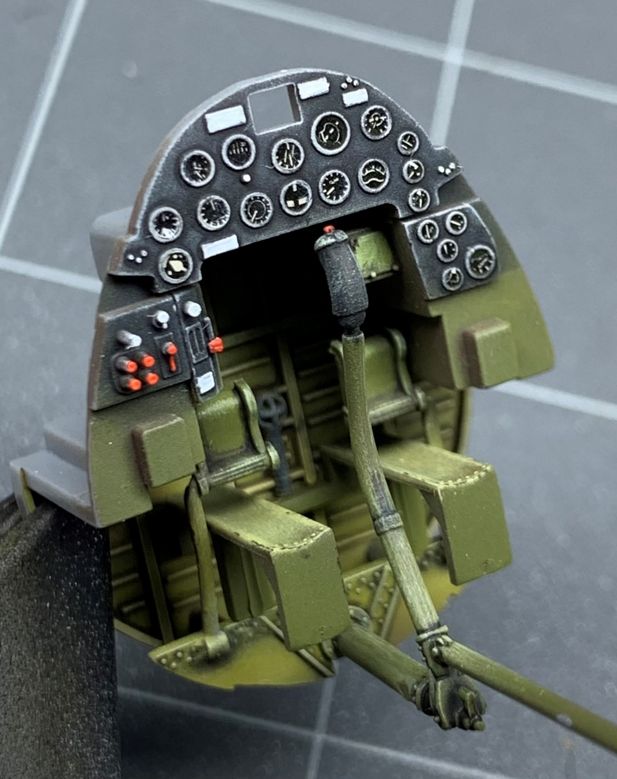
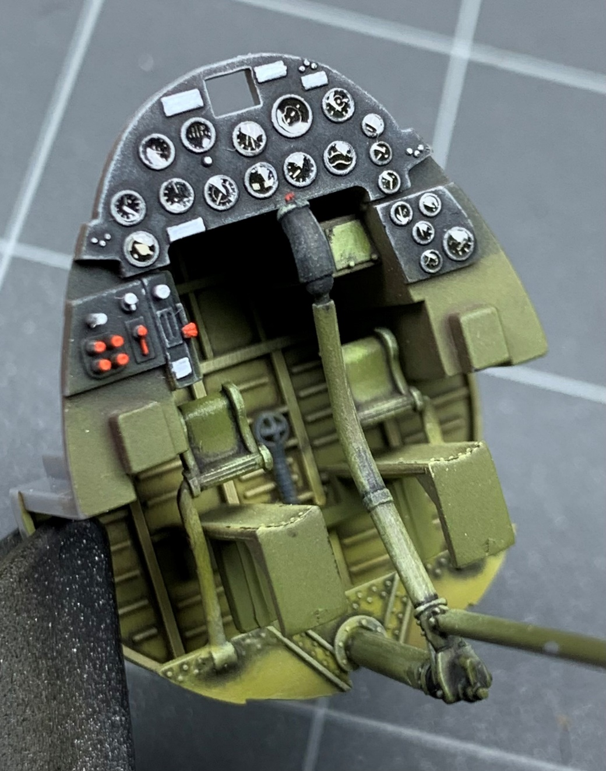
Tamiya 1/48 F4U-1A Cockpit by Justin Lentz…
*Bondic Pen (Clear Resin) for Instrument Bezel Glass

Slide 20
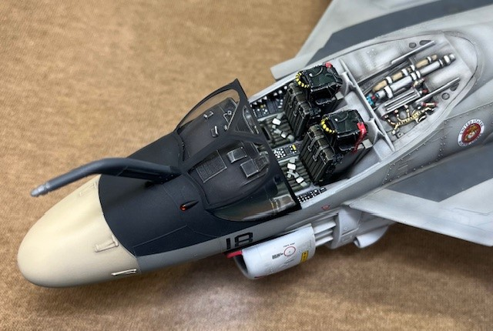
1/48 Revell EA-6A Cockpit …OOB

Slide 21
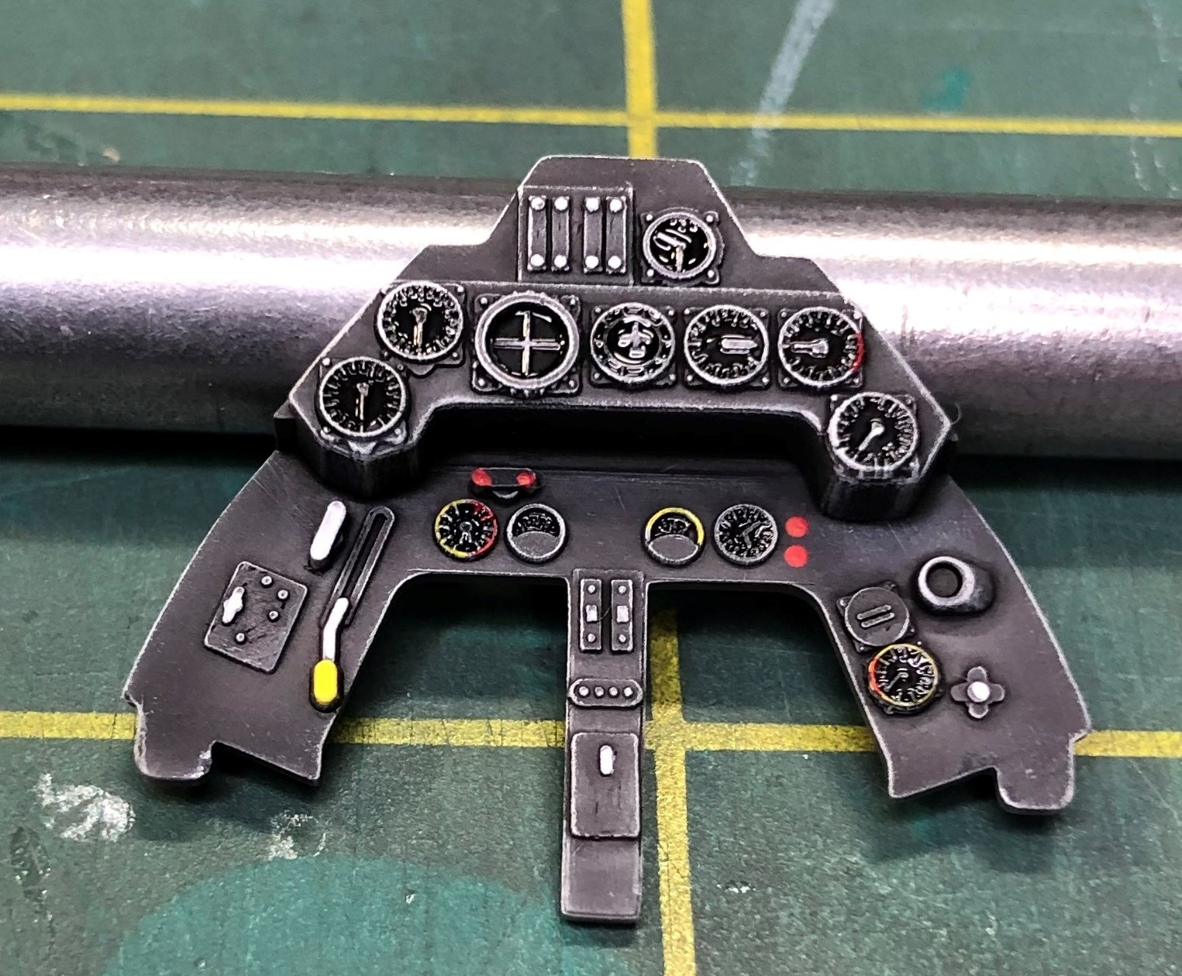
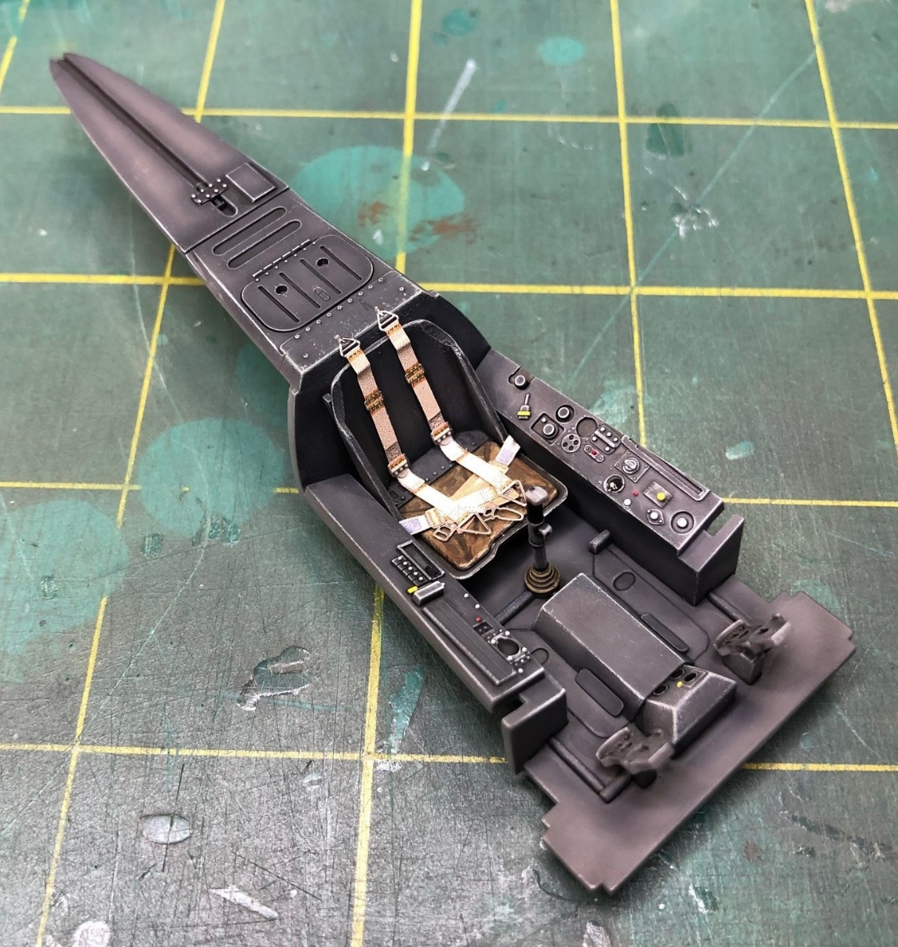
Hasegawa 1/32 Fw-190 Cockpit…

Slide 22
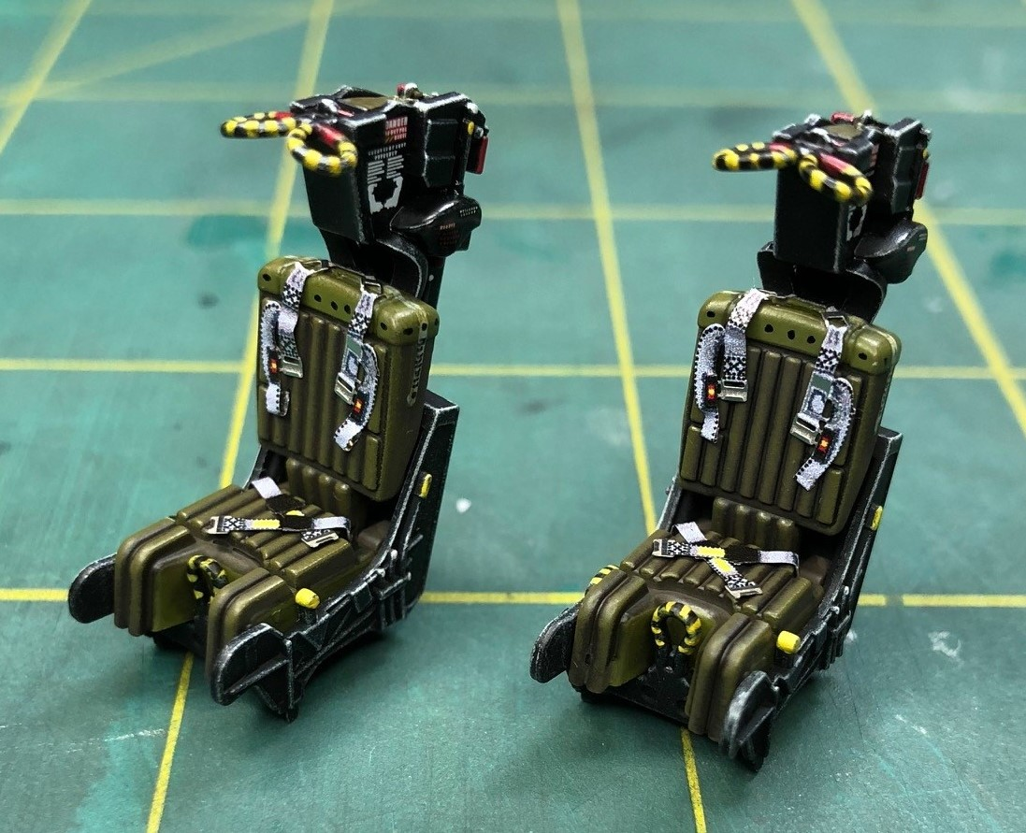
Eduard Seatbelts for the Tamiya F-14A

Slide 23
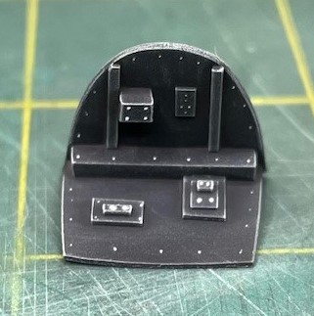
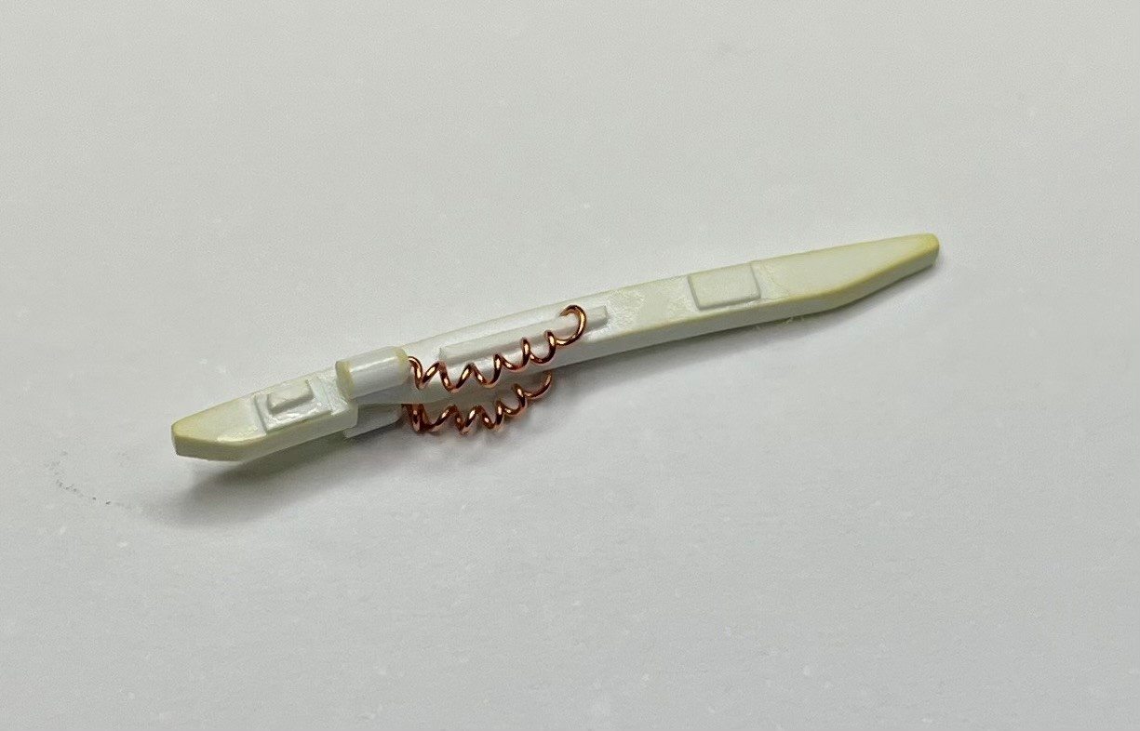
Simple Scratch-Built Details…
1/48 A-6E Overhead Console
1/48 A-4E Rear Bulkhead

Slide 24
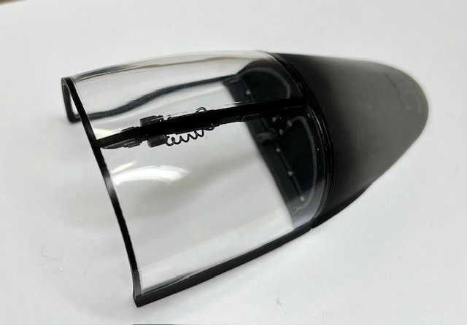
Simple Scratch-Built Details…
1/48 EA-6A Overhead Console

Slide 25

Modelgeeks Podcast
Questions??

